Slide 1

Chapter 10
Functional Dependencies and Normalization for Relational Databases

Slide 2
Functional Dependence (FD)
B -> A
-[A is functionally dependent on B]
-[B is functionally determine A]
Attribute(s) A is functionally dependent on attribute(s) B if: given a value b for B there is one and only one corresponding value a for A

Slide 3
Examples of FD constraints
social security number determines employee name
SSN -> ENAME
project number determines project name and location
PNUMBER -> {PNAME, PLOCATION}
employee ssn and project number determines the hours per week that the employee works on the project
{SSN, PNUMBER} -> HOURS

Slide 4
Keys
Primary Key is a minimal set of attributes that form a candidate key.
Any attribute or collection of attributes that functionally determine all attributes in a record is a Candidate Key.
Primary key fields must be unique and cannot contain a null value.
Each table should have a primary key field.
A key consisting of more than one attribute is called a “composite key.”

Slide 5
Foreign Keys
Foreign Key: Fields in a table that refer to the primary key in another table
The data in this field must exactly match data contained in the primary key field.
SalesRep(SalesRepNumber, Name)
[ 03 | Mary Jones ]
[ 124 | 03 ]
Customer(CustomerNumber, SalesRepNumber)

Slide 6
Database Normalization
Is a process for assigning attributes to entities. It reduces data redundancies and improves maintenance
Normalization works through a series of stages called normal forms:
  First normal form (1NF)
  Second normal form (2NF)
  Third normal form (3NF) ←ready to go ☺
  Fourth normal form (4NF)

Slide 7
1st Normal Form
  No multivalued or composite attributes
  each column has a single value
No redundant records
  use valid primary key

Slide 8
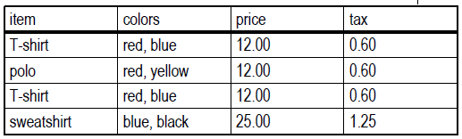
Example
Table’s FD:
item -> price
item -> tax
price-> tax
Table is not in first normal form because:
Multiple values in color field
Duplicate records / no primary key

Slide 9
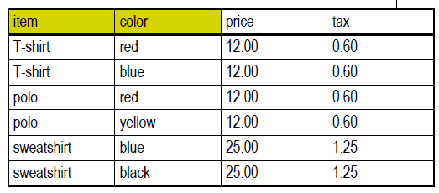
Example
Table’s FD:
item -> price
item -> tax
price-> tax
Table is now in first normal form.

Slide 10
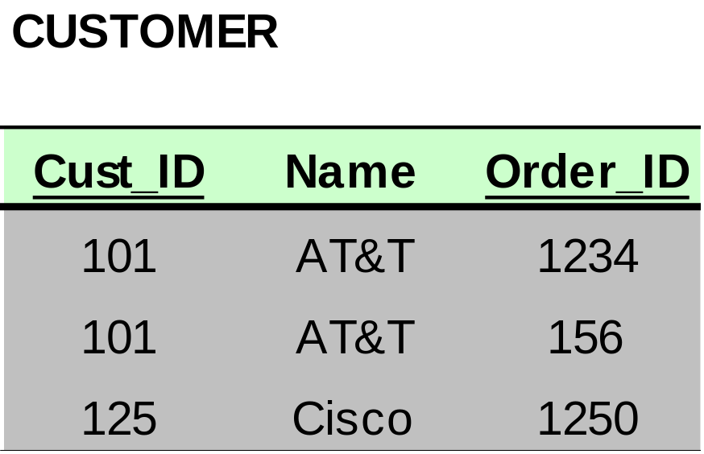
Dependencies: Definitions
Partial Dependency – when an non-key attribute is determined by a part, but not the whole, of a COMPOSITE primary key.
Partial Dependency

Slide 11
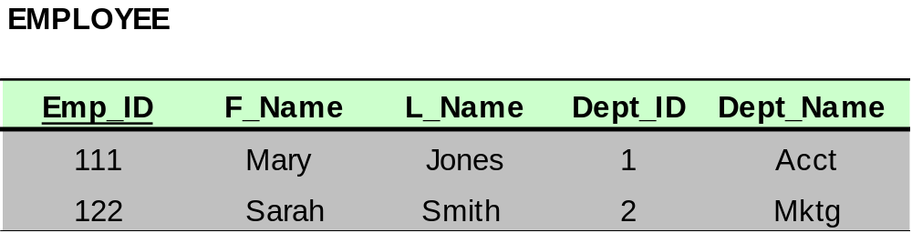
Dependencies: Definitions
Transitive Dependency – when a non-key attribute determines another non-key attribute.
Transitive Dependency

Slide 12
Normal Forms Summary
Not Normalized – There are multivalued attributes or redundant records
1 NF – No multivalued attributes or redundant records; there is primary key
2 NF – 1 NF plus no partial dependencies
3 NF – 2 NF plus no transitive dependencies

Slide 13
Normal Forms Summary
Not Normalized
1st NF
2nd NF
3rd NF

Slide 14
Example
Table’s FD:
item -> price
item -> tax
price-> tax
Table in first NF, not in second normal form because:
  price and tax depend only on item (not item and color)

Slide 15
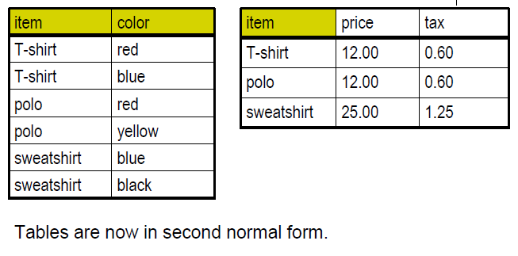
Example
Tables’ FD:
item -> price
item -> tax
price-> tax
Tables in Second NF, not in third NF because tax depends on price

Slide 16
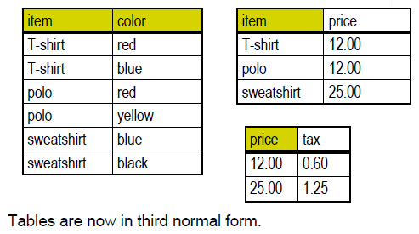
Example
Tables’ FD:
item -> price
item -> tax
price-> tax

Slide 17
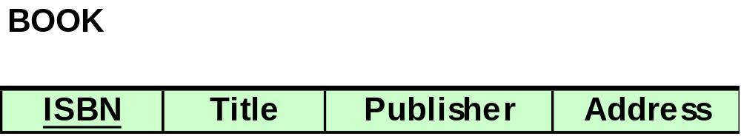
Example 1: Determine NF?
The relation is in 2NF.
ISBN → Title
ISBN → Publisher
Publisher → Address

Slide 18
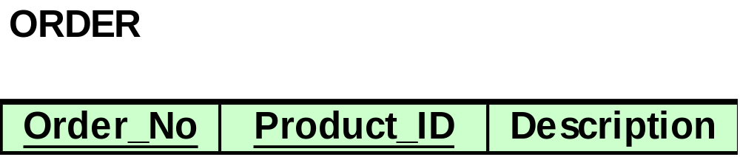
Example 2: Determine NF?
Product_ID → Description
The relation is in 1 NF.

Slide 19
Normalization Exercise
What is the highest normal form for the following relation?
Table(f1, f2, f3, f4, f5, f6, f7, f8, f9, f10)
FDs are:
f10 → f8, f6
f9 → f1, f5
F9, f10 → f2, f3, f4, f7
The relation is in 1 NF.

Slide 20
Normalization Exercise
What is the highest normal form for the following relation?
Table(f1, f2, f3, f4, f5, f6, f7, f8, f9, f10)
FDs are:
f10 → f8, f6
f8 → f4
f9 → f1, f5
f1 → f7, f3
F9, f10 → f2
The relation is in 1 NF.

Slide 21
Normalization Exercise
What is the highest normal form for the following relation?
Table(f1, f2, f3, f4, f5, f6, f7, f8, f9, f10)
FDs are:
f1 → f4
f6 → f1, f5
f9, f10 → f1, f2, f3, f4, f5, f6, f7, f8
The relation is in 2 NF.

Slide 22
Normalization Exercise
What is the primary key for this relation?
Book(Book_title, Authorname, Book_type, price, Author_address, Publisher)
FDs are:
Book_title → Publisher, Book_type
Book_type → price
Authorname →Author_address
PK:Book_titl and
Authorname

Slide 23
Normalization Steps:
To 1st Normal Form
  Remove redundancy
  Each attribute should has single value
  Build valid primary key

Slide 24
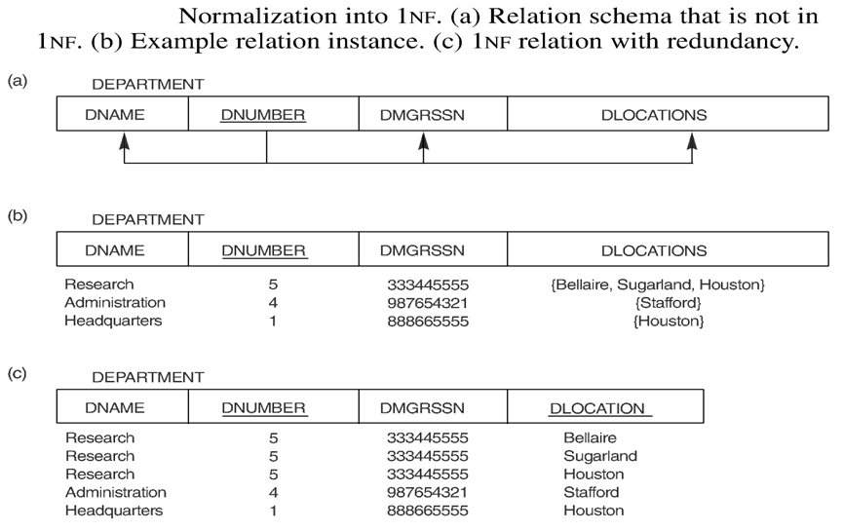
Company Example

Slide 25
To 2nd Normal Form
In 1st normal form
Remove partial dependencies
  Guaranteed when primary key is a single field.
Example:
Order-Part(OrderNumber | PartNumber | PartDescription)
This relation is not in 2nd NF
mapping it to 2nd NF:
Create a new table with PartNumber key.
Order-Part(OrderNumber | PartNumber)
Part( PartNumber | PartDescription)

Slide 26
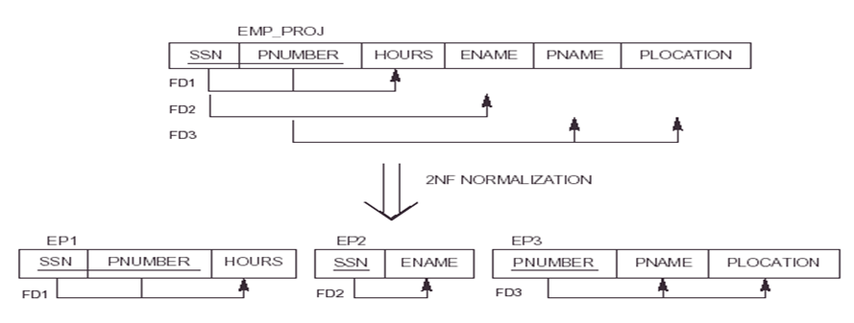
Company Example

Slide 27
To 3rd Normal Form
In 2nd normal form
Remove transitive dependencies

Slide 28
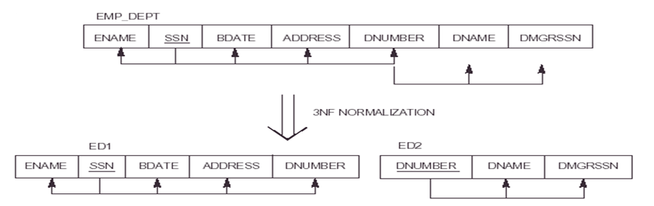
Company Example

Slide 29
Example: Data in Students Transcript
Transcript( Student#, StudentName, Dbirth, Dept#, DeptName, CourseNo, CourseName, Semester, Grade, Pass/Fail)
FDs are:
  Student# → StudentName, Dbirth, Dept#
  Dept# → DeptName
  CourseNo → CourseName
  Student# , Semester, CourseNo → Grade, Pass/Fail
  Grade → Pass/Fail

Slide 30
Mapping to 1st Normal Form:
Build Valid PK
Transcript( Student#, StudentName, Dbirth, Dept#, DeptName, CourseNo, CourseName, Semester, Grade, Pass/Fail)
FDs are:
  Student# → StudentName, Dbirth, Dept#
  Dept# → DeptName
  CourseNo → CourseName
  Student# , Semester, CourseNo → Grade, Pass/Fail
  Grade → Pass/Fail

Slide 31
Mapping to 2nd Normal Form:
Remove Partial Dependency
Transcript(Student#, CourseNo, Semester, Grade, Pass/Fail)
Student(Student#, StudentName, Dbirth, Dept#, DeptName)
Course(CourseNo, CourseName)
FDs are:
  Student# → StudentName, Dbirth, Dept#
  Dept# → DeptName
  CourseNo → CourseName
  Student# , Semester, CourseNo → Grade, Pass/Fail
  Grade → Pass/Fail

Slide 32
Mapping to 3rd Normal Form:
Remove Transitive Dependency
Transcript(Student#, CourseNo, Semester, Grade)
Student(Student#, StudentName, Dbirth, Dept#)
Course(CourseNo, CourseName)
Department(Dept#, DeptName)
Sgrade(Grade, Pass/Fail)
FDs are:
  Student# → StudentName, Dbirth, Dept#
  Dept# → DeptName
  CourseNo → CourseName
  Student# , Semester, CourseNo → Grade, Pass/Fail
  Grade → Pass/Fail

Slide 33
Normalization Exercise
Normalize the following relation to 3 NF:
Book(Book_title, Authorname, Book_type, price, Author_address, Publisher)
FDs are:
Book_title → Publisher, Book_type
Book_type → price
Authorname →Author_address

Slide 34
Normalization Exercise
Normalize the following relation to 3 NF:
COMPANY RECORD SYSTEM
Project#, Prj-name, Start-date, Prj‑status, Employee#, Emp-name, Department#, Department-name, Working-hours
FDs are
Project#→ Prj-name, Start-date, Prj‑status
Employee# → Emp-name, Department#
Department# → Department-name
Project#, Employee# → Working-hours

Slide 35
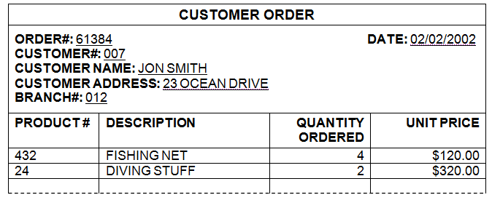
Normalization Exercise

Slide 36
Normalization Exercise
Normalize the following relation to 3 NF:
Table(f1, f2, f3, f4, f5, f6, f7, f8, f9, f10)
FDs are:
f6 → f8, f10
f2 → f4, f6
f3 → f1, f5
f1 → f7, f9

Slide 37
Normalization Exercise
STOCK LIST
Store ID: M515
Store Name: Southside Hardware
Part Number | Part Description | Supplier Number | Supplier Name | Supplier Address | Qty on Hand | Cost Price | Total Cost
3541 | Bolt 5cm | 34513 | Acme | USA | 546 | $0.70 | $382.20
4325 | Washer 30mm | 57952 | Washer Co | UK | 567 | $0.12 | $68.04
5678 | Nut 8mm | 34513 | Acme | USA | 342 | $0.17 | $58.14
1478 | Screw 40mm | 00975 | Fasteners | UK | 1267 | $0.09 | $114.03
---- | ----- | ---- | ----- | ----- | --- | --- | ---
 |  |  |  | Total Stock Cost |  |  | $708.66

Slide 38
Normalization Exercise
Normalize the following relation to 3 NF:
Table(f1, f2, f3, f4, f5, f6, f7, f8, f9, f10)
FDs are:
f6 → f8, f10
f2 → f4
f3 → f1
f2, f3 → f5
f1 → f7, f9

Slide 39
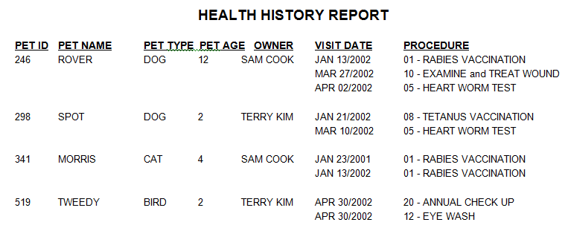
Normalization Exercise

